Slide 1
Logic COMP2620/COMP6262/PHIL2080
Tutorial
Week3

Slide 2
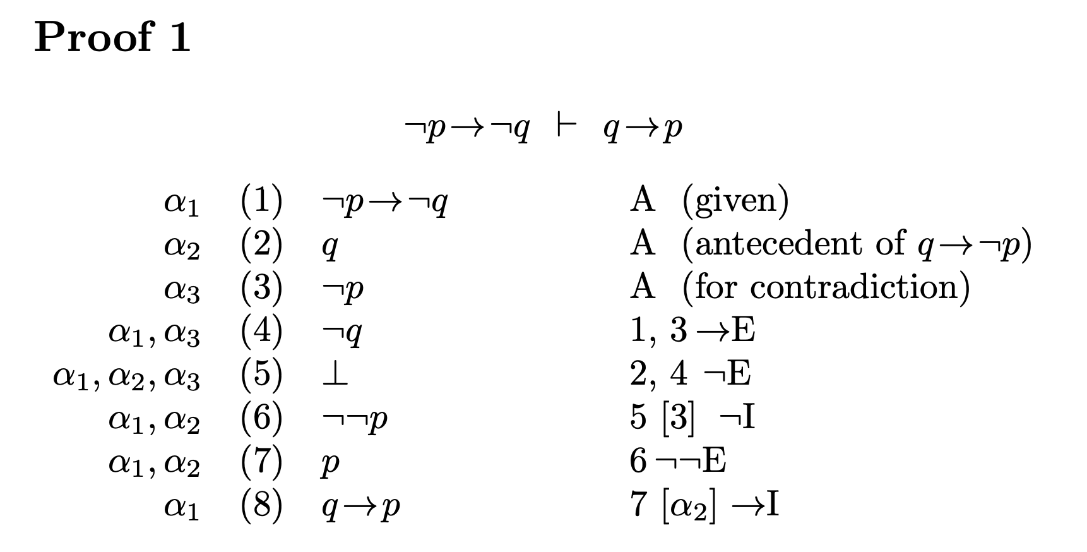
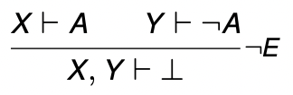
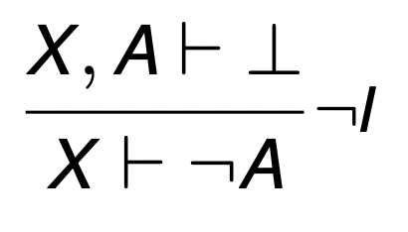
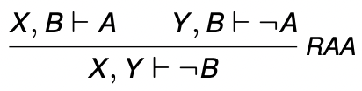
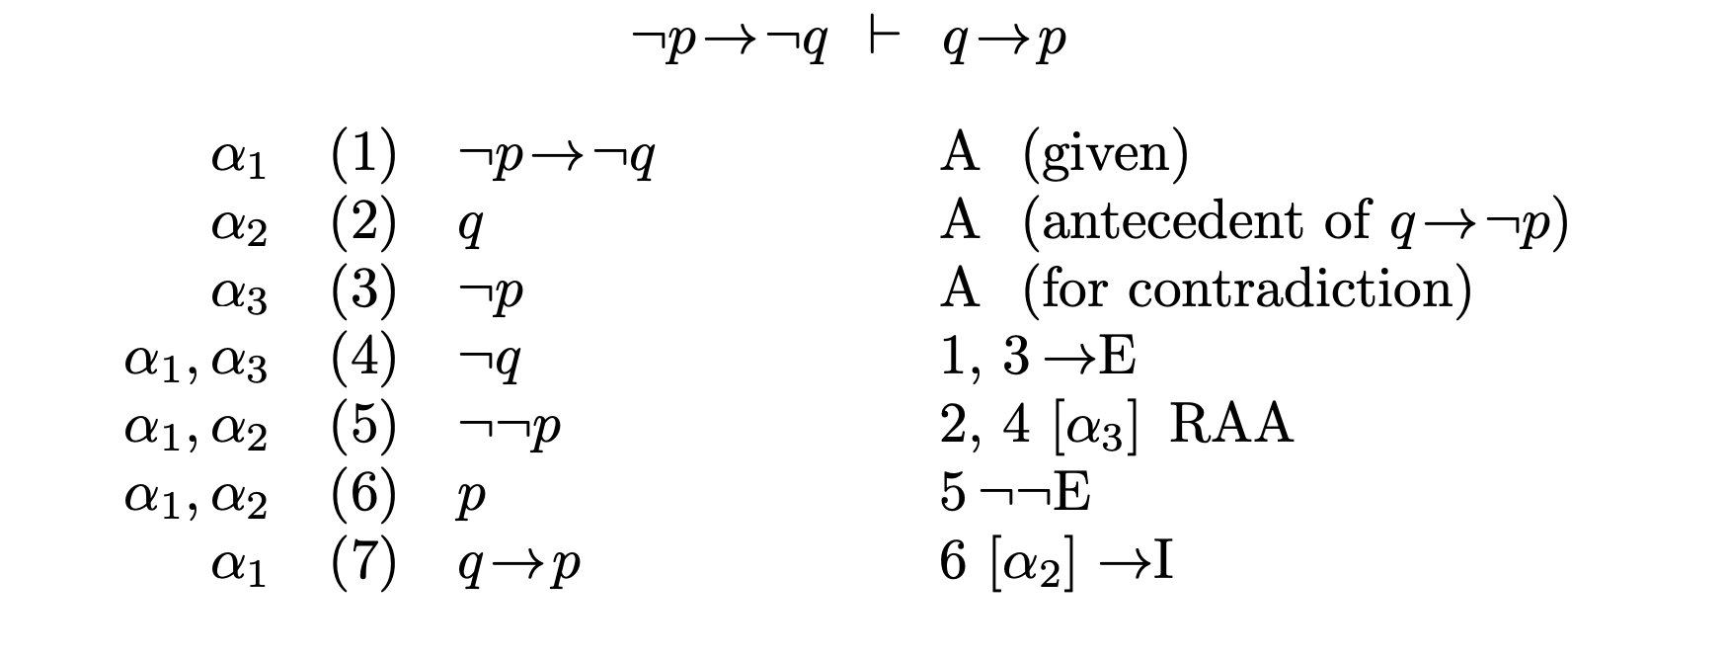
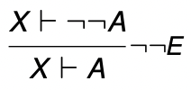
The symbol for “⊥” "bottom" (also called "false") represents a logical value that is always false.
When using ¬I, it is necessary to discharge the conditional formula being used. Discharge α3 and delate α3 from α 1,α2,α3
[α3]
RAA is employed when you want to prove the truth of a proposition by assuming the opposite (negation) of that proposition and then demonstrating that this assumption leads to a logical contradiction or an absurdity.

Slide 3
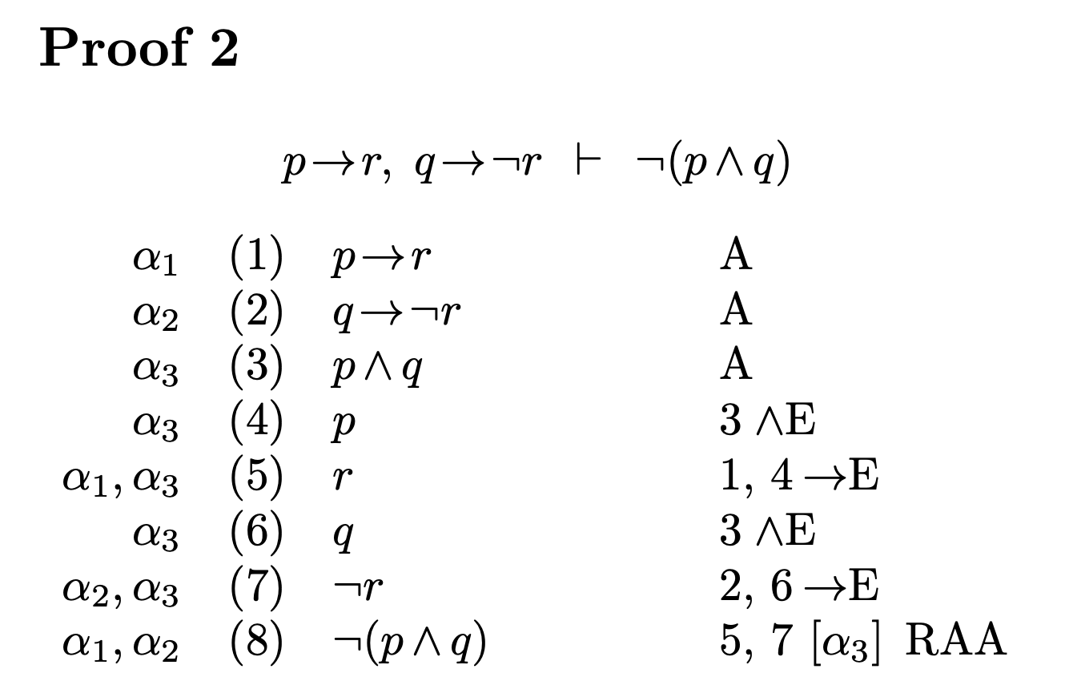
contradiction
In this case r and ¬r is contradict, this is because we assume p ∧ q not ¬(p ∧ q )

Slide 4
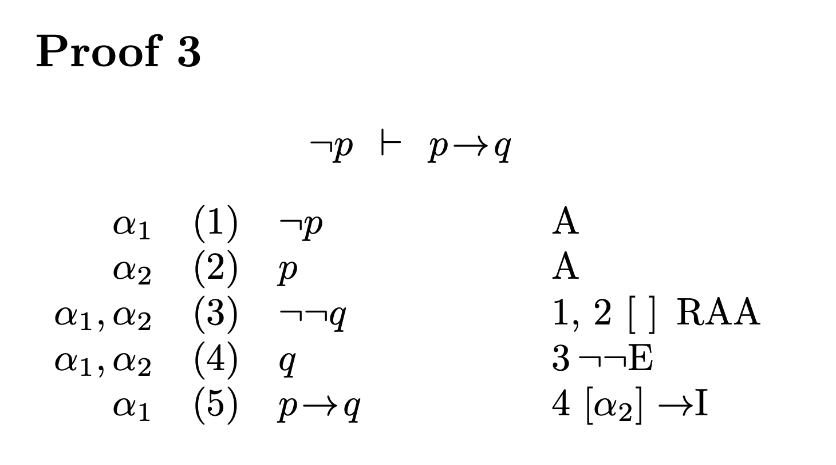
[] illustrates vacuous discharge with RAA. Vacuous discharge allows formulae that do not appear in the derivation at all to be treated as though the conclusion came from them
α1 （1） ¬ p A
α2 （2） p A
α3 （3） ¬ q A
α1 α2 （4） ⊥ 1,2, ¬ E
α1 α2 （5） ¬ ¬ q A
α1 α2 （6） ¬ ¬ q 5,[α3], ¬ I
α1 α2 （7） q ¬ ¬ E
α2 （8） p → q 7, [α1] ,→ I

Slide 5
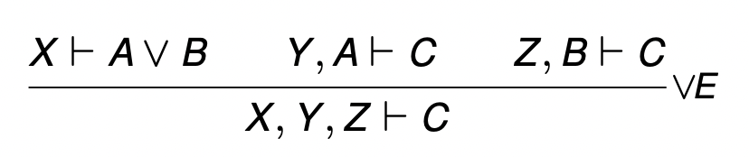
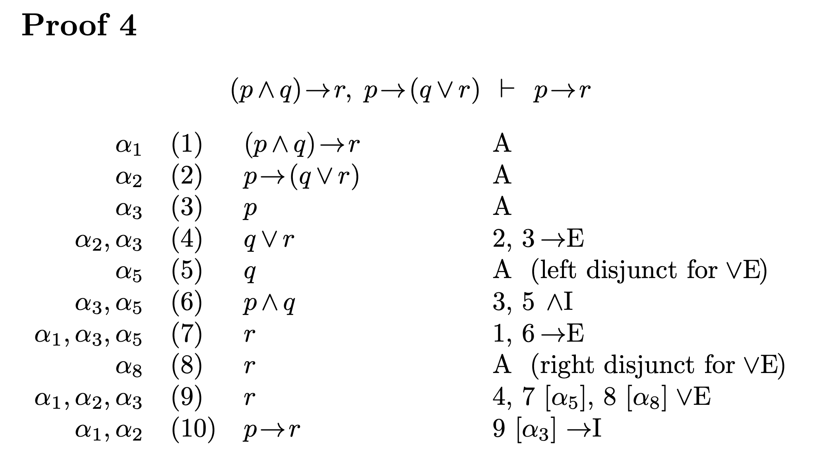
X= p→(q ∨ r), p Y= (p ∧ q)→ r, p, q Z= r
A= q B= r C= r
When using ∨ E, it is necessary to discharge the conditional formula being used.
X
Y
Z
When using ∨ E, it is necessary to discharge the conditional formula being used.

Slide 6
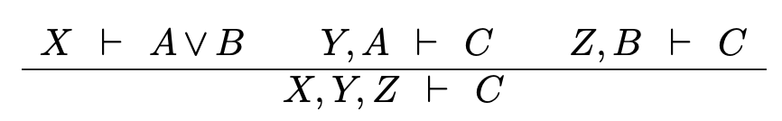
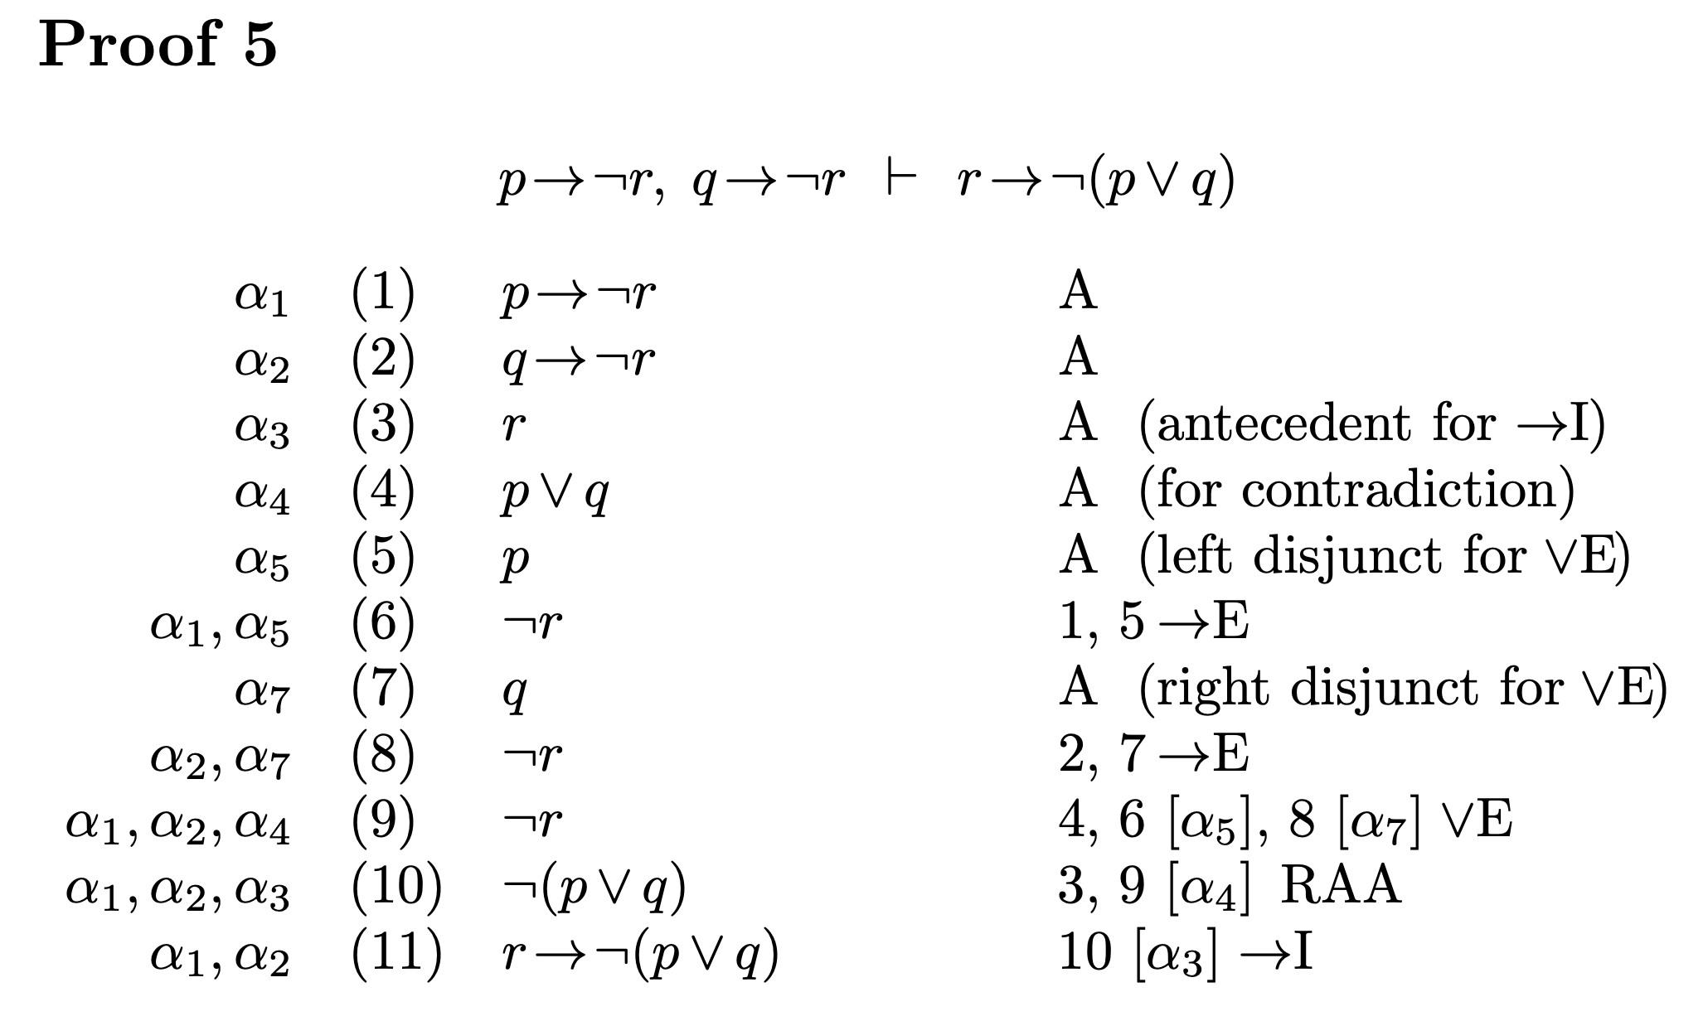
X= p ∨ q Y= p → ¬ r Z= q → ¬ r
A= p B= q C= ¬ r
Y
Z
X

Slide 7
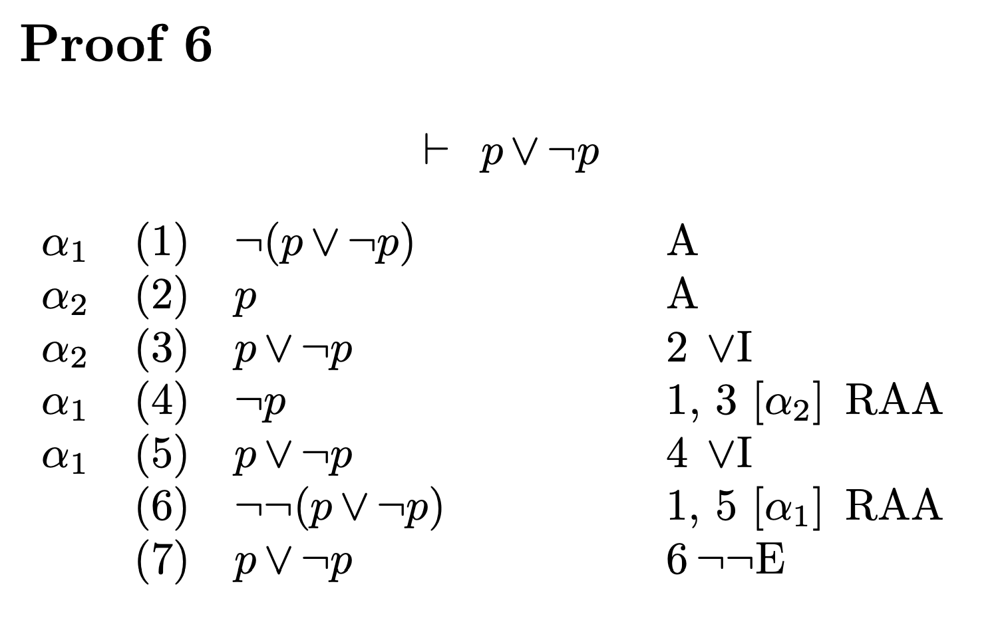
This is the Law of Excluded Middle (LEM)
it must be either true or false, and there is no middle ground or third option
we have to assume that
it is false and derives a contradiction from that.
(contradiction)
¬¬E is essential to the proof.

Slide 8
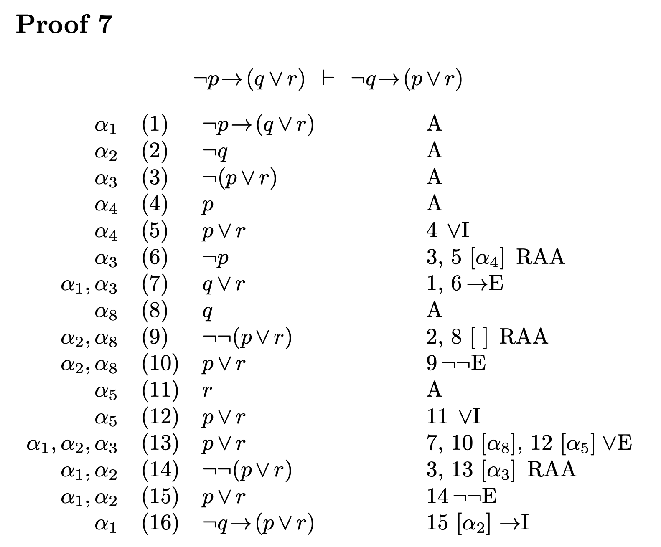
X= ¬p → (q ∨ r), ¬(p ∨ r ) Y = ¬q, q Z= p ∨ r
A= q B= r C= p ∨ r
∨I rule you can introduce new logical expressions.
Premise 1: P is true.
Conclusion: P ∨ Q is true.
In this case, since P is true, P ∨ Q is also true.
(contradiction)
[] illustrates vacuous discharge

